Slide 1
Momentum Contrast for Unsupervised Visual Representation Learning
2019 - Kaiming He, Haoqi Fan, Yuxin Wu, Saining Xie, Ross Girshick
MoCo

Slide 2

Self-supervised Learning
Fine-tune
network
Image segmentation
Pre-train
Fine-tune
network
network
Object detection
Fine-tune
network
No label
Classification
With label

Slide 3
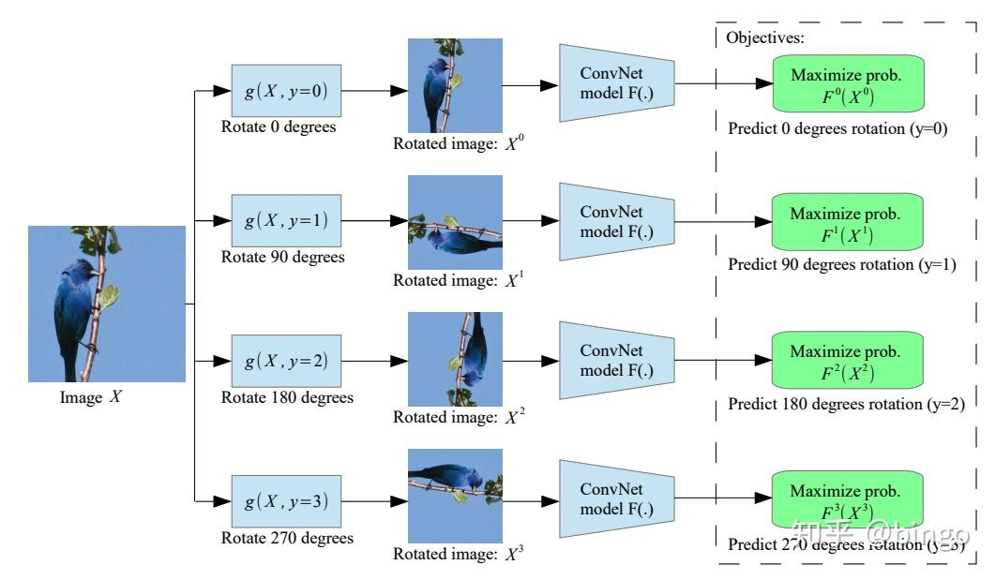
Pretext task
Unsupervised Representation Learning by Predicting Image Rotations

Slide 4
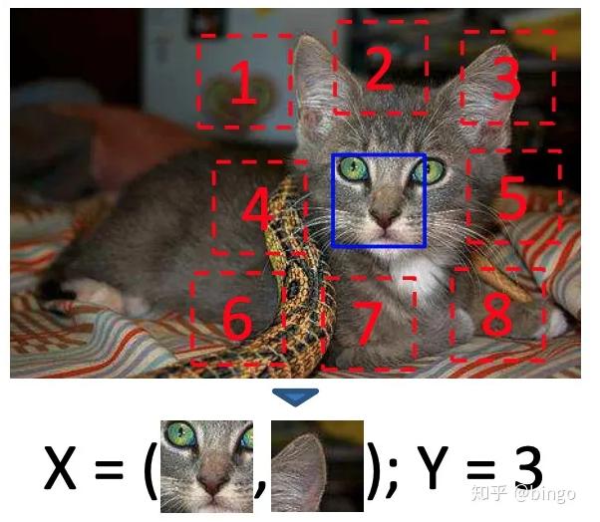
Pretext task
Unsupervised Visual Representation Learning by Context Prediction

Slide 5
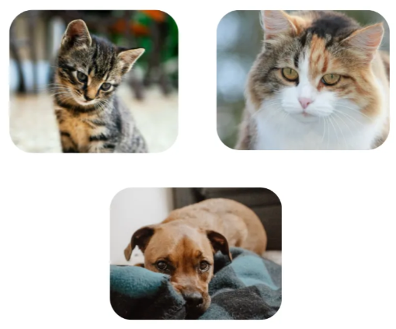
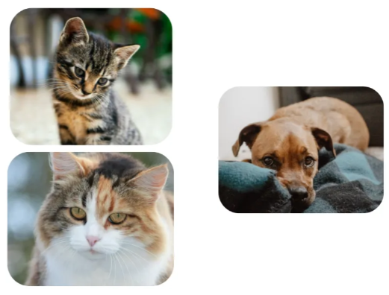
Contrastive Learning 對比學習
network
不相似
相似

Slide 6
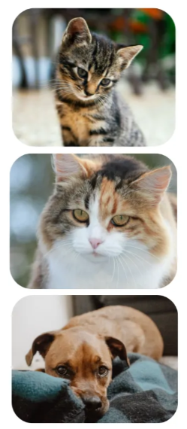

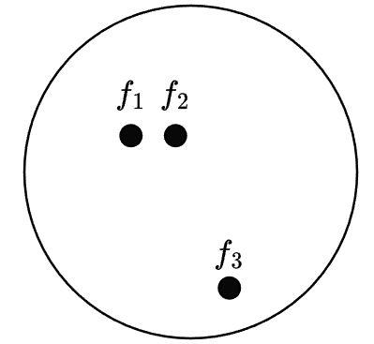
Contrastive Learning 對比學習
Embedding Space 特徵空間
network
How to train this?
沒有label怎麼知道哪張圖片是相似的?

Slide 7
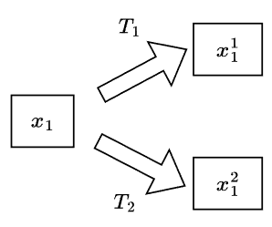




Instance Discrimination
Positive Sample 正樣本
每張圖片都是一個 class
n 張圖片
Negative Sample 負樣本
network
Loss calculation

Slide 8
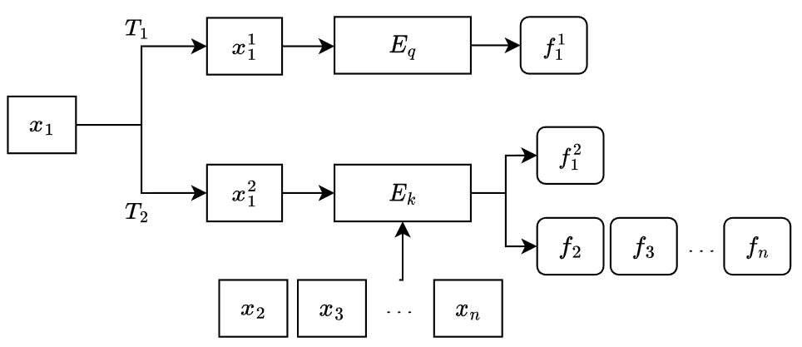
Contrastive Learning + Instance Discrimination
Positive Sample 正樣本
Negative Sample 負樣本
n 張圖片

Slide 9
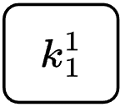
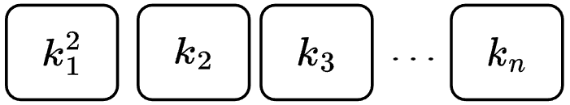


What MoCo thinks
Train encoders to perform dictionary look-up
query
dictionary
key
key
key
key
similar
Matching key
dissimilar

Slide 10
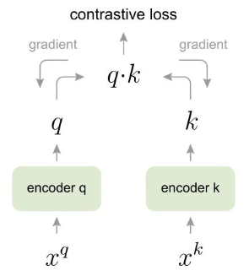
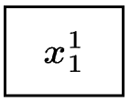
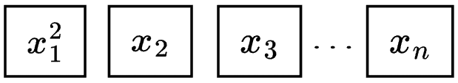
Before MoCo – End-to-End model
假設 mini-batch size 是 n
query
dictionary
字典裡 key 的數量就是 mini-batch size n
由於 GPU 記憶體的限制，batch size 不能設太大，字典裡的 key 數量就受限於 batch size。
一個mini-batch的data進去

Slide 11

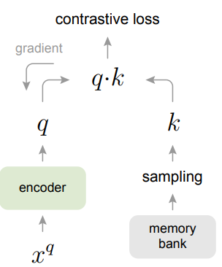




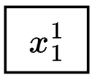

Before MoCo – memory bank
Memory bank has N keys
假設 dataset 有 N 張圖片
New key
更新參數後的 encoder
query
Dictionary has K keys
Update
Sample K keys
優點：dictionary 的 key 數量 K 不用因為 GPU記憶體的限制而受限於 batch size n

Slide 12


Before MoCo – memory bank
Memory bank has N keys
第一版的encoder算出來
第二版的encoder算出來
更新參數後的 encoder
New key
假設 K = 1
Update
第三版的encoder算出來
缺點：
Memory bank (dictionary) 內的 key 是由不同的 encoder 算出來的。
當 dataset 數量龐大，memory bank 的 key 數量就很大。

Slide 13

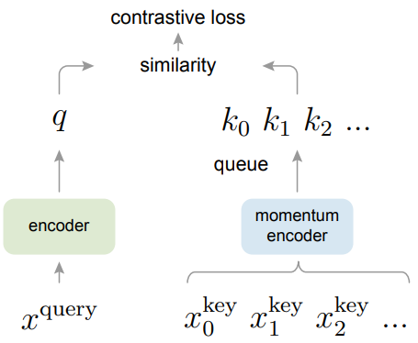



MoCo use queue
用queue 儲存 dictionary
dequeue n 個 key
Dictionary has K keys
Enqueue n 個 key 進入 dictionary
經過 momentum encoder 得到 feature
一個mini-batch的data進去

Slide 14




Momentum update encoder
: Momentum encoder 的參數
: query encoder 的參數
: momentum coefficient

Slide 15
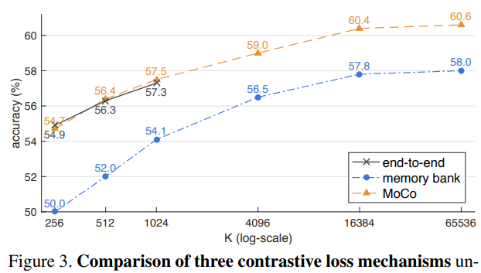
Experiment：Linear Classification Protocol
Dataset：ImageNet-1K，1 million images
Network：ResNet-50
Pre-trained the network on IM-1K, than freeze the features and fine-tune a supervised linear classifier

Slide 16
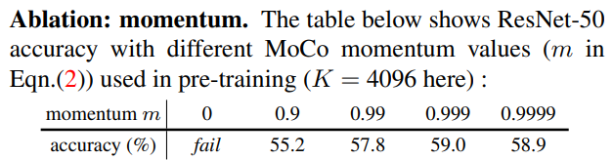
Experiment：Linear Classification Protocol

Slide 17
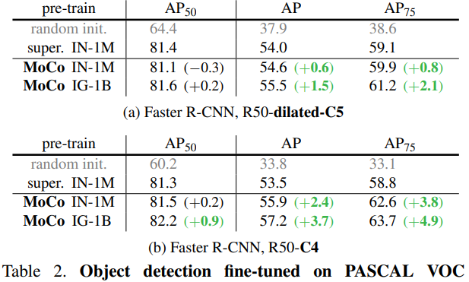
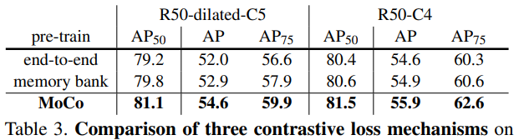
Experiment：Transferring Features
Pre-train a network, than fine-tuned all the network using supervised hyperparameter

Slide 18
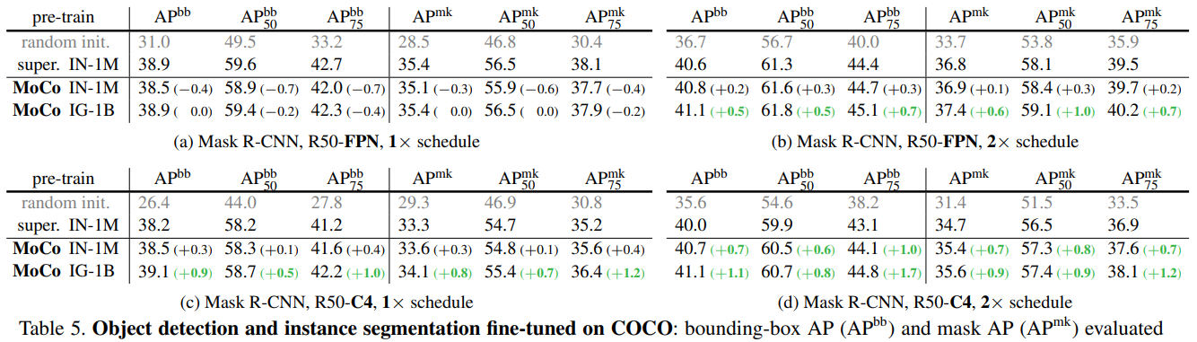
Experiment：Transferring Features
Pre-train a network, than fine-tuned all the network using supervised hyperparameter

Slide 19
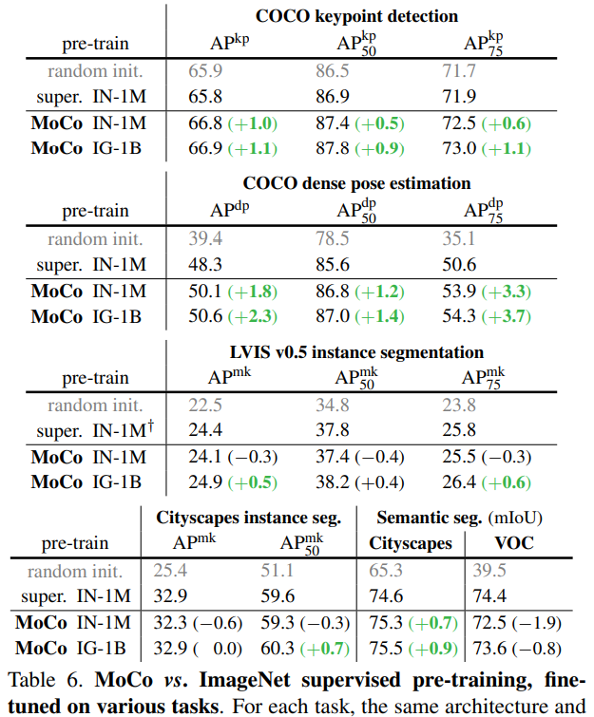

Slide 20

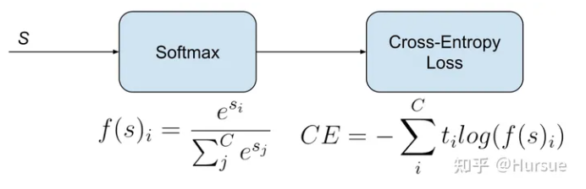

Loss function MoCo use
InfoNCE (Noise Contrastive Estimation)

